Slide 1

TEAM 34: XIN'AI HAO; DOAN LE; YANZE LIU; YANG XIAO; JIAYI YU; NINA ZHUANG
DATA SCIENCE FOR BUSINESS
BANKRUPTCY PREDICTION
14 OCTOBER, 2025

Slide 2

BUSINESS UNDERSTANDING
BANKRUPTCY → PORTFOLIO LOSS→ RISK-ADJUSTED DECISION MAKING.
Institutional investors face significant losses from unexpected corporate bankruptcies.
Our project aims to predict which firms are likely to fail and translate predictions into portfolio optimization under different risk preferences.

Slide 3
BUSINESS UNDERSTANDING
how will a data mining solution address the problem?
DATA MINING SOLUTION
ML Model
Financial Data And Bank Status
Cost-Benefit Matrix
Bankruptcy Probability
Maximized Expected Return
Optimal Investment Threshold

Slide 4


DATA UNDERSTANDING
A novel dataset for U.S. public companies listed on the NYSE and NASDAQ is used for bankruptcy prediction.
It contains accounting financial data from 8,262 firms between 1999–2018, totaling 78,682 firm-year observations with no missing or synthetic values.
According to the SEC, bankruptcy in the U.S. occurs under two legal codes:
Chapter 11 – reorganization while continuing operations.
Chapter 7 – complete liquidation and business termination.
For modeling, the fiscal year before bankruptcy filing (under either Chapter 11 or 7) is labeled as Bankrupt (1), and all other firm-years are labeled as Alive (0).
Source: https://www.kaggle.com/datasets/utkarshx27/american-companies-bankruptcy-prediction-dataset/data

Slide 5
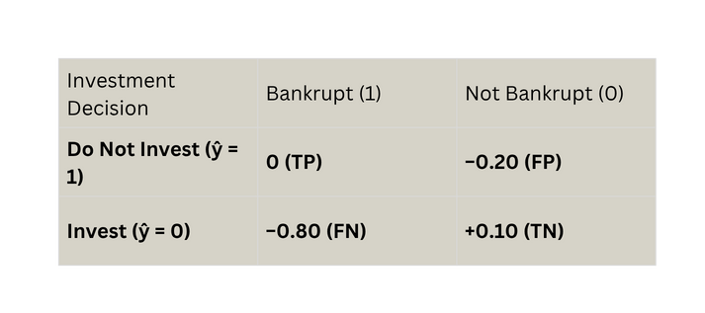
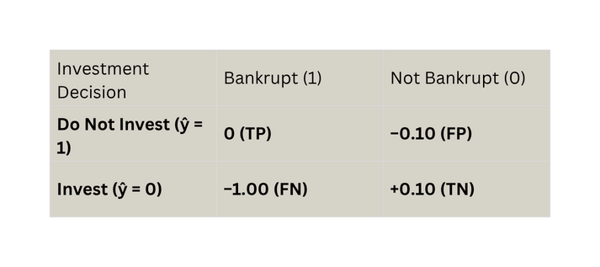
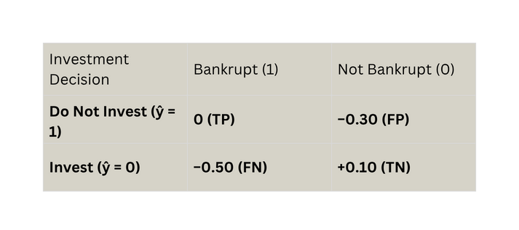
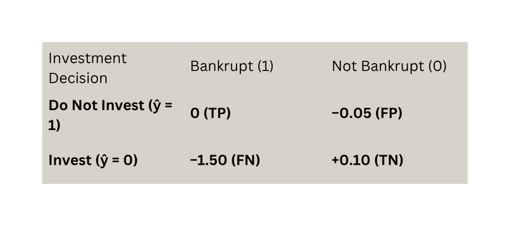
DATA UNDERSTANDING
Conservative Investor
Neutral Investor
Aggressive Investor
Speculative Investor

Slide 6

DATA PREPARATION
STEP 2：FEATURE ENGINEERING
STEP 1：FEATURE CLEANING AND REDUCTION
New ratio-based variables were engineered to capture normalized firm-level financial health
Removed redundant or collinear features (X9, X12, X13, X18) after correlation analysis
STEP 3：TRANSFORMATION AND ENCODING
STEP 4：DATASET PARTITIONING
specify how these data are integrated to produce the format required
Converted target variable status_label to binary.
Applied StandardScaler to normalize all numeric variables.
Used SMOTE (Synthetic Minority Oversampling Technique) to balance class distribution and mitigate bias.

Slide 7


MODELING
Model | Advantages | Disadvantages
Random Forest | Captures nonlinear relationships; highly robust and stable | Limited interpretability; can be slower on large datasets
XGBoost | High predictive performance; flexible tuning options | Complex parameter optimization; may risk overfitting
Logistic Regression | Simple and interpretable; good baseline for comparison | Limited expressive power; struggles with nonlinear patterns
SVM | Effective in high-dimensional spaces; performs well with clear margins | Computationally expensive; less interpretable and sensitive to parameter choice
We ultimately selected Random Forest as the core model since it provides the best balance between predictive accuracy, stability, and interpretability in bankruptcy risk estimation.

Slide 8

MODEL EVALUATION
Model | Conservative | Neutral | Aggressive | Speculative | Overall Performance | Remarks
Random Forest | th=0.37, ret=0.041 | th=0.45, ret=0.050 | th=0.52, ret=0.052 | th=0.66, ret=0.064 | Best practical model | Stable, accurate, interpretable.
XGBoost | th=0.35, ret=0.039 | th=0.54, ret=0.047 | th=0.79, ret=0.050 | th=0.91, ret=0.064 | High returns | High gains but unrealistic thresholds.
Logistic Regression (L2) | th=0.55, ret=0.007 | th=0.57, ret=0.030 | th=0.93, ret=0.040 | th=1.00, ret=0.060 | Moderate baseline | Simple and interpretable, but weak on nonlinearity.
SVM | th=0.56, ret=0.005 | th=0.58, ret=0.030 | th=0.86, ret=0.041 | th=1.00, ret=0.060 | Moderate baseline | Similar to Logit; poor probability calibration.

Slide 9
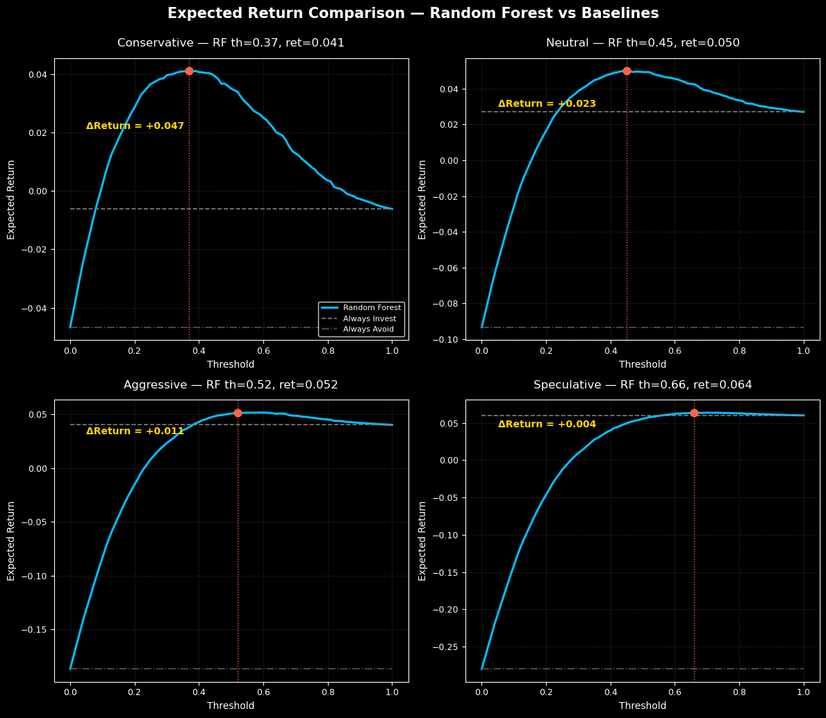
DEPLOYMENT

Slide 10

WE WANT TO SAY
THANK YOU
FOR YOUR ATTENTION

